Slide 1
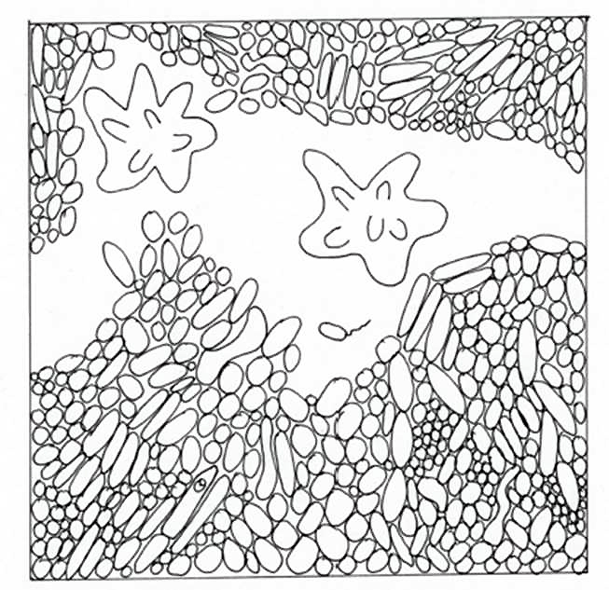

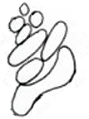

Colour a biofilm
with University of Birmingham, School of Dentistry
Did you know biofilms are found everywhere, including on our teeth?
You might know them as dental plaque and they are made up of bacteria
Colour a biofilm
with University of Birmingham, School of Dentistry
Did you know biofilms are found everywhere, including on our teeth?
You might know them as dental plaque and they are made up of bacteria
Our white blood cells, such as neutrophils, help fight bacteria and biofilms
Our white blood cells, such as neutrophils, help fight bacteria and biofilms
Bacteria come in different shapes
Bacteria come in different shapes
Can you find our clock tower Old Joe?
Can you find our clock tower Old Joe?

